Slide 1
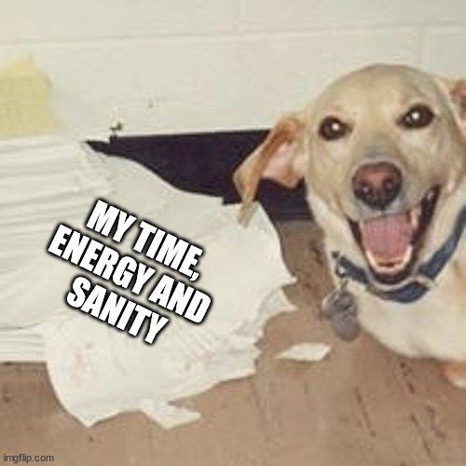
Starvation Free SJF Process Schedular
This research project
Luc van den Enden
Fontys ICT

Slide 2
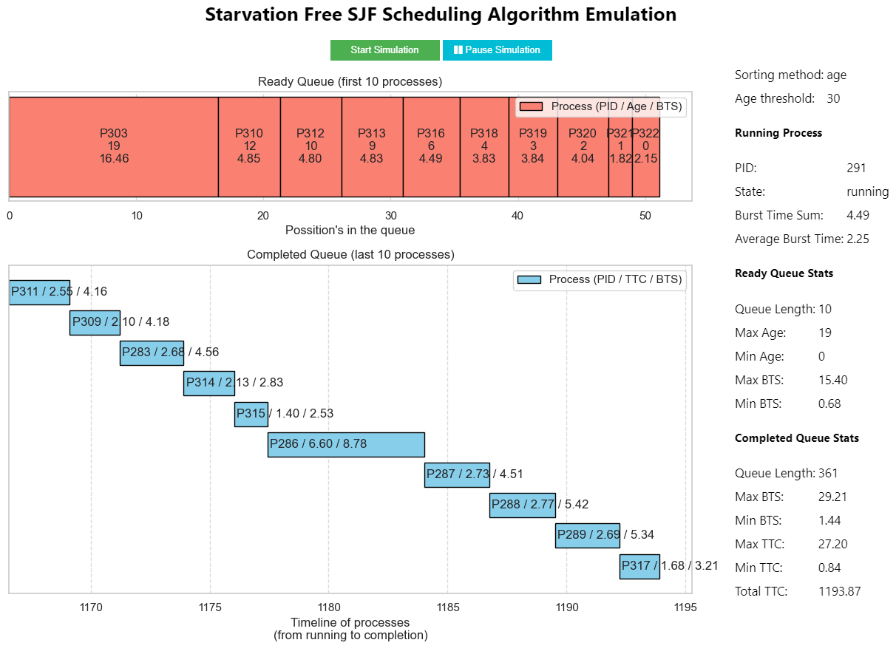

About SJF
Simple (it just works)
Low average waiting time
Non-Preemptive
Extremely primitive compared to others
High variance waiting time
Prone to starvation

Slide 3
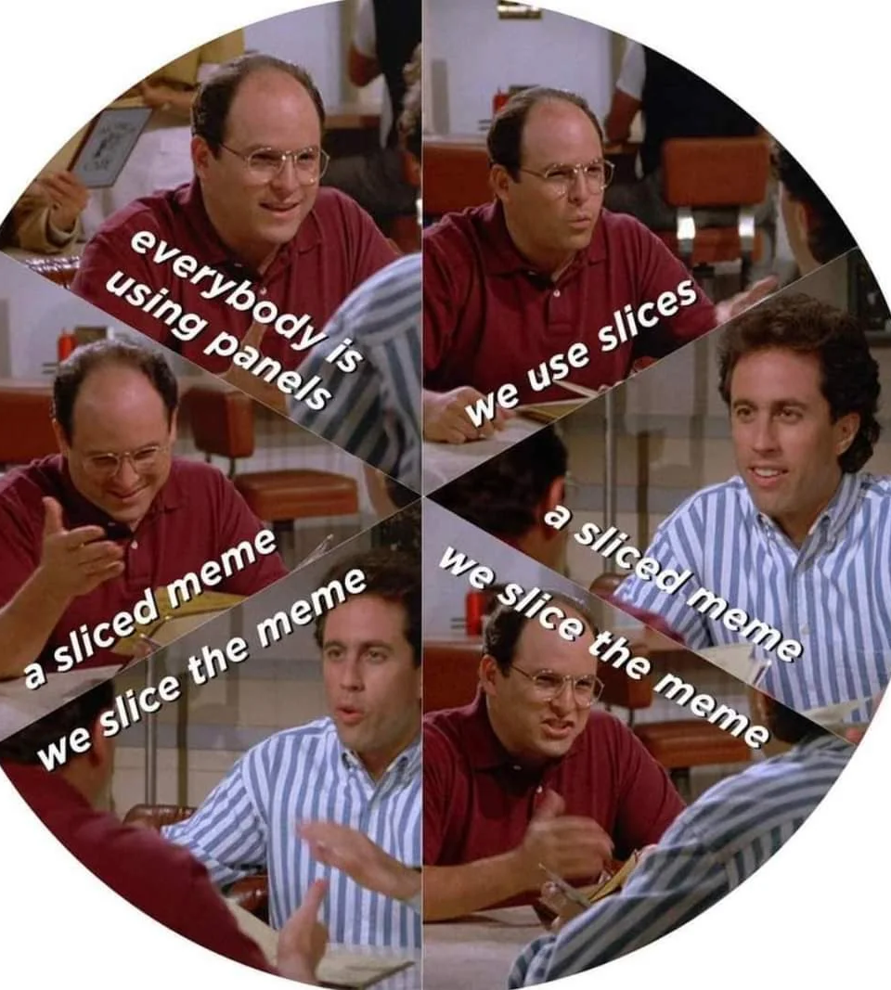


Solutions for starvation in SJF
Dynamic Time-Slicing
Priority Queue’s
Queue Item Aging

Slide 4
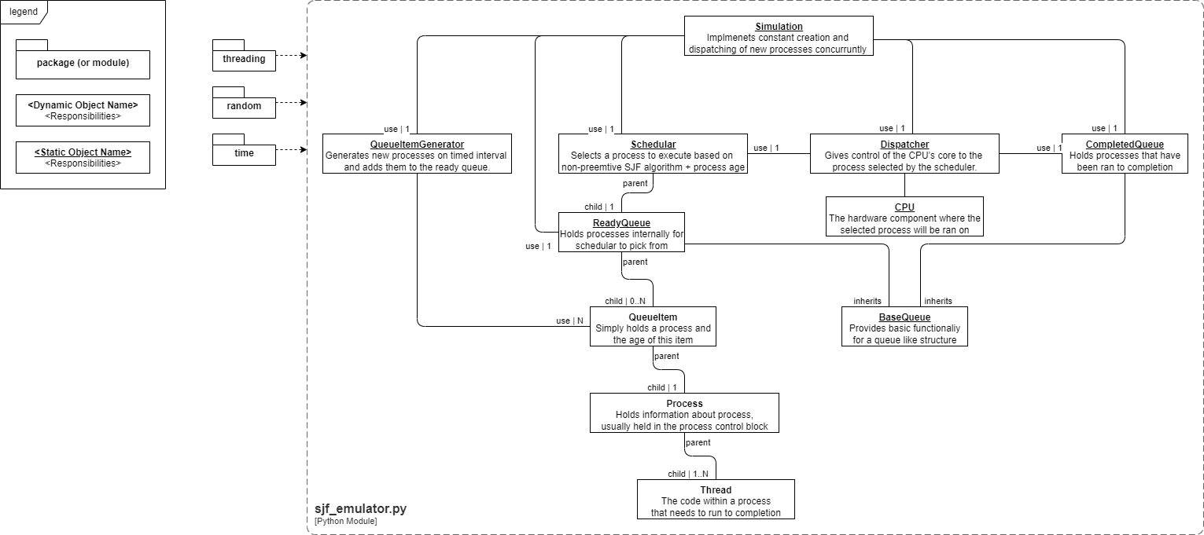
Simulating SJF

Slide 5

DEMO

